Slide 1
Logistic Regression
INFO-4604, Applied Machine Learning
University of Colorado Boulder

Slide 2
Linear Classification
w^{T}x_{i} is the classifier score for the instance x_{i}
The score can be used in different ways to make a classification.
Perceptron: output positive class if score is at least 0, otherwise output negative class
Today: output the probability that the instance belongs to a class

Slide 3
Activation Function
An activation function for a linear classifier converts the score to an output.
Denoted ϕ(z), where z refers to the score, w^{T}x_{i}

Slide 4
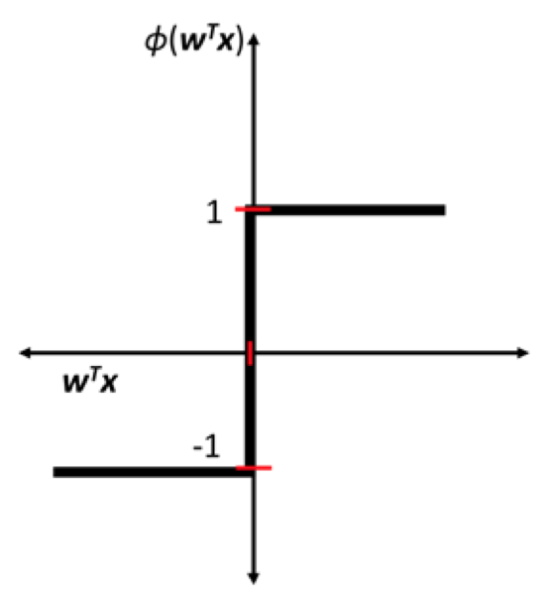
Activation Function
Perceptron uses a threshold function:
ϕ(z) = 1, z ≥ 0
-1, z < 0

Slide 5
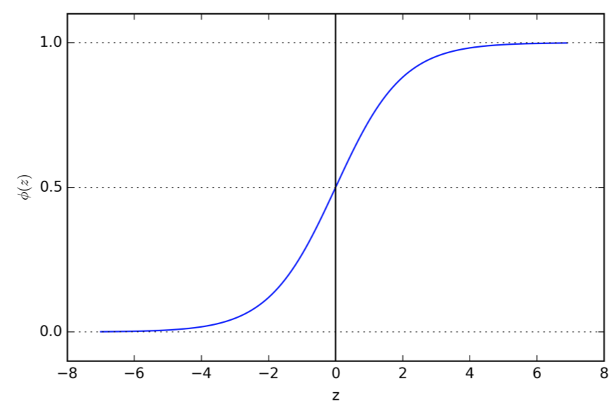
Activation Function
Logistic function:
ϕ(z) = 1
1 + e^{-z}
The logistic function is a type of sigmoid function (an S-shaped function)

Slide 6
Activation Function
Logistic function:
ϕ(z) = 1
1 + e^{-z}
Outputs a real number between 0 and 1
Outputs 0.5 when z=0
Output goes to 1 as z goes to infinity
Output goes to 0 as z goes to negative infinity

Slide 7
Quick note on notation: exp(z) = e^{z}

Slide 8
Logistic Regression
A linear classifier like perceptron that defines…
Score: w^{T}x_{i} (same as perceptron)
Activation: logistic function (instead of threshold)
This classifier gives you a value between 0 and 1, usually interpreted as the probability that the instance belongs to the positive class.
Final classification usually defined to be the positive class if the probability ≥ 0.5.

Slide 9
Logistic Regression
Confusingly: This is a method for classification, not regression.
It is regression in that it is learning a function that outputs continuous values (the logistic function), but you are using those values to predict discrete classes.

Slide 10
Logistic Regression
Confusingly:
Considered a linear classifier, even though the logistic function is not linear.
This is because the score is a linear function, which is really what determines the output.

Slide 11
Learning
How do we learn the parameters w for logistic regression?
Last time: need to define a loss function and find parameters that minimize it.

Slide 12
Probability
Because logistic regression’s output is interpreted as a probability, we are going to define the loss function using probability.
For help with probability, review OpenIntro Stats, Ch 2.

Slide 13
Probability
A conditional probability is the probability of a random variable given that some variables are known.
P(Y | X) is read as “the probability of Y given X”
or “the probability of Y conditioned on X”
The variable on the left hand side is what you want to know the probability of.
The variable on the right-hand side is what you know.

Slide 14
Probability
P(y_{i} = 1 | x_{i}) = ϕ(w^{T}x_{i})
P(y_{i} = 0 | x_{i}) = 1 – ϕ(w^{T}x_{i})
Goal for learning: learn w that makes the labels in your training data more likely
The probability of something you know to be true is 1, so that’s what the probability should be of the labels in your training data.
Note: the convention for logistic regression is that the classes are 1 and 0 (instead of 1 and -1)

Slide 15
Learning
P(y_{i} | x_{i}) = ϕ(w^{T}x_{i})^{y}i * (1 – ϕ(w^{T}x_{i}))^{1–y}i

Slide 16
Learning
P(y_{i} | x_{i}) = ϕ(w^{T}x_{i})^{y}i * (1 – ϕ(w^{T}x_{i}))^{1–y}i
if y_{i} = 1

Slide 17
Learning
P(y_{i} | x_{i}) = ϕ(w^{T}x_{i})^{y}i * (1 – ϕ(w^{T}x_{i}))^{1–y}i
if y_{i} = 0

Slide 18
Learning
P(y_{i} | x_{i}) = ϕ(w^{T}x_{i})^{y}i * (1 – ϕ(w^{T}x_{i}))^{1–y}i
or
log P(y_{i} | x_{i}) = y_{i} log(ϕ(w^{T}x_{i})) + (1–y_{i}) log(1–ϕ(w^{T}x_{i}))
Taking the logarithm (base e) of the probability makes the math work out easier.

Slide 19
Learning
log P(y_{i} | x_{i}) = y_{i} log(ϕ(w^{T}x_{i})) + (1–y_{i}) log(1–ϕ(w^{T}x_{i}))
This is the log of the probability of an instance’s label y_{i} given the instance’s feature vector x_{i}
What about the probability of all the instances?
log P(y_{i} | x_{i})
This is called the log-likelihood of the dataset.
N
i=1

Slide 20
Learning
Our goal was to define a loss function for logistic regression. Let’s use log-likelihood… almost.
A loss function refers specifically to something you want to minimize (that’s why it’s called “loss”), but we want to maximize probability!
So let’s minimize the negative log-likelihood:
L(w) = -log P(y_{i} | x_{i}) = -y_{i} log(ϕ(w^{T}x_{i})) – (1–y_{i}) log(1–ϕ(w^{T}x_{i}))
N
N
i=1
i=1

Slide 21
Learning
We can use gradient descent to minimize the negative log-likelihood, L(w)
The partial derivative of L with respect to w_{j} is:
dL/dw_{j} = x_{ij} (y_{i} – ϕ(w^{T}x_{i}))
N
i=1

Slide 22
Learning
We can use gradient descent to minimize the negative log-likelihood, L(w)
The partial derivative of L with respect to w_{j} is:
dL/dw_{j} = x_{ij} (y_{i} – ϕ(w^{T}x_{i}))
if y_{i} = 1…
The derivative will be 0 if ϕ(w^{T}x_{i})=1
(that is, the probability that y_{i}=1 is 1, according to the classifier)
N
i=1

Slide 23
Learning
We can use gradient descent to minimize the negative log-likelihood, L(w)
The partial derivative of L with respect to w_{j} is:
dL/dw_{j} = x_{ij} (y_{i} – ϕ(w^{T}x_{i}))
if y_{i} = 1…
The derivative will be positive if ϕ(w^{T}x_{i}) < 1
(the probability was an underestimate)
N
i=1

Slide 24
Learning
We can use gradient descent to minimize the negative log-likelihood, L(w)
The partial derivative of L with respect to w_{j} is:
dL/dw_{j} = x_{ij} (y_{i} – ϕ(w^{T}x_{i}))
if y_{i} = 0…
The derivative will be 0 if ϕ(w^{T}x_{i})=0
(that is, the probability that y_{i}=0 is 1, according to the classifier)
N
i=1

Slide 25
Learning
We can use gradient descent to minimize the negative log-likelihood, L(w)
The partial derivative of L with respect to w_{j} is:
dL/dw_{j} = x_{ij} (y_{i} – ϕ(w^{T}x_{i}))
if y_{i} = 0…
The derivative will be negative if ϕ(w^{T}x_{i}) > 0
(the probability was an overestimate)
N
i=1

Slide 26
Learning
We can use gradient descent to minimize the negative log-likelihood, L(w)
The partial derivative of L with respect to w_{j} is:
dL/dw_{j} = x_{ij} (y_{i} – ϕ(w^{T}x_{i}))
So the gradient descent update for each w_{j} is:
w_{j} -= η x_{ij} (y_{i} – ϕ(w^{T}x_{i}))
N
i=1
N
i=1

Slide 27
Learning
So gradient descent is trying to…
make ϕ(w^{T}x_{i}) = 1 if y_{i} = 1
make ϕ(w^{T}x_{i}) = 0 if y_{i} = 0

Slide 28
Learning
So gradient descent is trying to…
make ϕ(w^{T}x_{i}) = 1 if y_{i} = 1
make ϕ(w^{T}x_{i}) = 0 if y_{i} = 0
But there’s a problem…
ϕ(z) = 1
1 + e^{-z}
z would have to be ∞ (or -∞) in order to make ϕ(z) equal to 1 (or 0)

Slide 29
Learning
So gradient descent is trying to…
make ϕ(w^{T}x_{i}) = 1 if y_{i} = 1
make ϕ(w^{T}x_{i}) = 0 if y_{i} = 0
Instead, make “close” to 1 or 0
Don’t want to optimize “too” much while running gradient descent

Slide 30
Learning
So gradient descent is trying to…
make ϕ(w^{T}x_{i}) = 1 if y_{i} = 1
make ϕ(w^{T}x_{i}) = 0 if y_{i} = 0
Instead, make “close” to 1 or 0
We can modify the loss function that basically means, get as close to 1 or 0 as possible but without making the w parameters too extreme.
How? That’s for next time.

Slide 31
Learning
Remember from last time:
Gradient descent
Uses the full gradient
Stochastic gradient descent (SGD)
Uses an approximate of the gradient based on a single instance
Iteratively update the weights one instance at a time
Logistic regression can use either, but SGD more common, and is usually faster.

Slide 32
Prediction
The probabilities give you an estimate of the confidence of the classification.
Typically you classify something positive if ϕ(w^{T}x_{i}) ≥ 0.5, but you could create other rules.
If you don’t want to classify something as positive unless you’re really confident, use ϕ(w^{T}x_{i}) ≥ 0.99 as your rule.
Example: spam classification
Maybe worse to put a legitimate email in the spam box than to put a spam email in the inbox
Want high confidence before calling something spam

Slide 33
Other Disciplines
Logistic regression is used in other ways.
Machine learning is focused on prediction (outputting something you don’t know).
Many disciplines is it as a tool to understand relationships between variables.
What demographics are correlated with smoking?
Build a model that “predicts” if someone is a smoker based on some variables (e.g., age, education, income).
The parameters can tell you which variables increase or decrease the likelihood of smoking.

